Slide 1


“EmpowerHer : A Smart Period Alert System for Differently - Abled Girls”
CSE - G
1.Sathwika-24RH1A05DH
2.Harshini-24RH1A05EH
3.Rohitha-24RH1A0CX

Slide 2
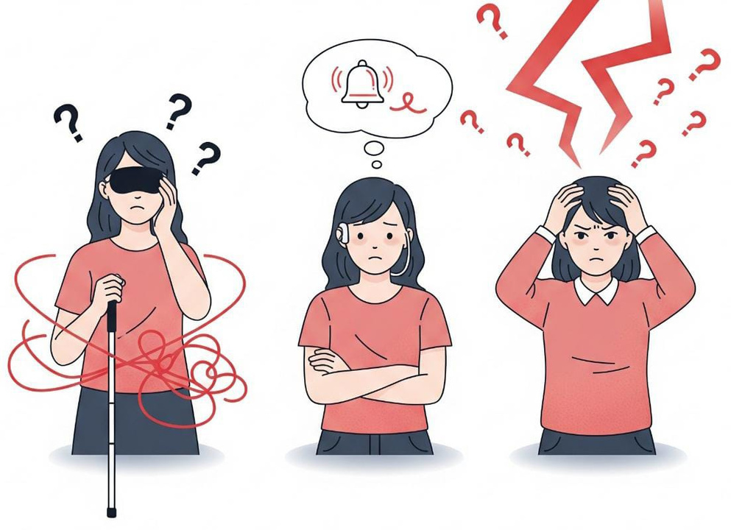

Problem Statement :
Lack of an accessible period alert system makes it difficult for blind, deaf, or mentally challenged girls to track their cycles, affecting their hygiene, health, and confidence.
Problem Solution :
A smart period alert system with sensors, wearable band, and mobile app is proposed. It provides vibrationt to the band, voice, or visual alerts to help disabled girls track periods and maintain hygiene.

Slide 3

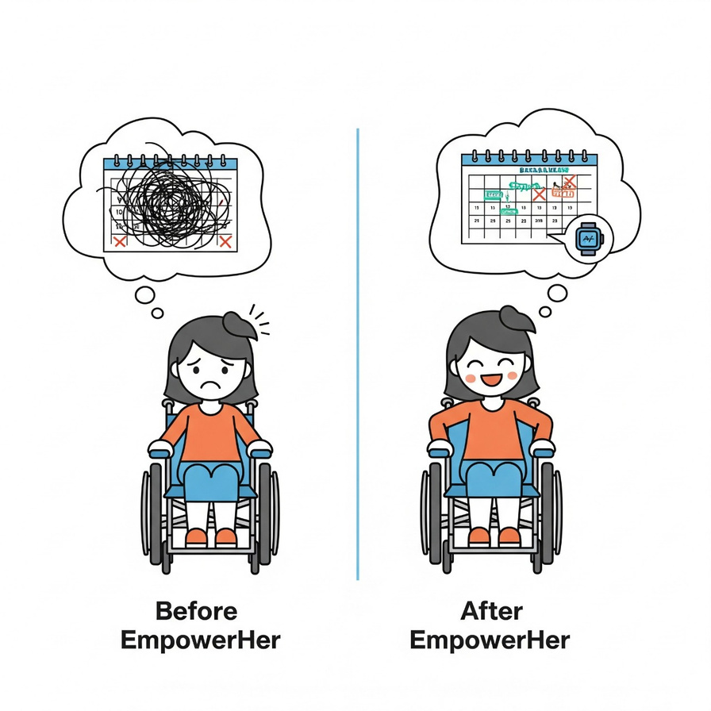


How to address the solution :
A sensor detects the start of menstruation and sends signals to a wearable band and mobile app. The band alerts through vibration/voice/visual notifications, ensuring timely awareness and hygiene.
Innovation and Uniquesness :
Unlike normal smartwatches that rely on apps, our device detects real menstruation with sensors and gives inclusive alerts for disabled girls.

Slide 4


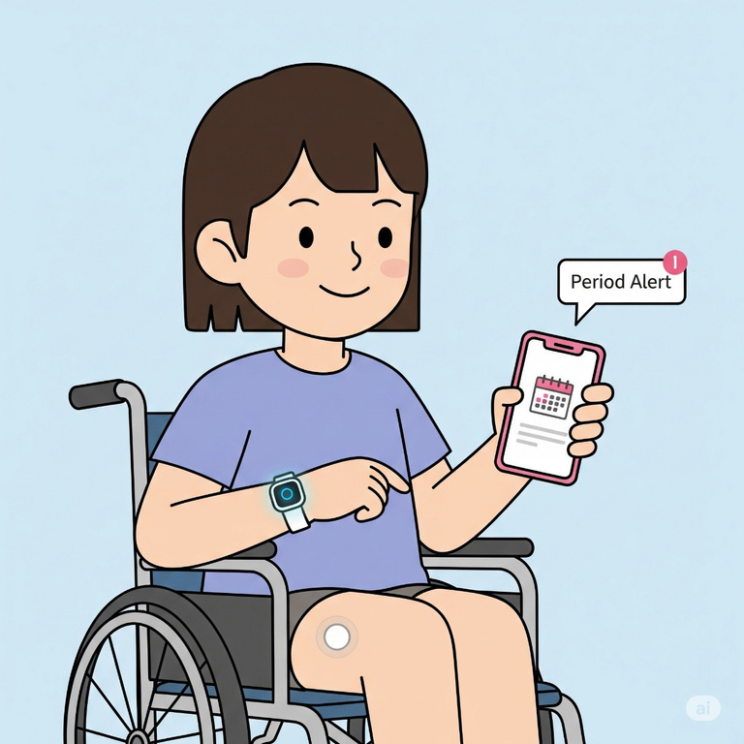
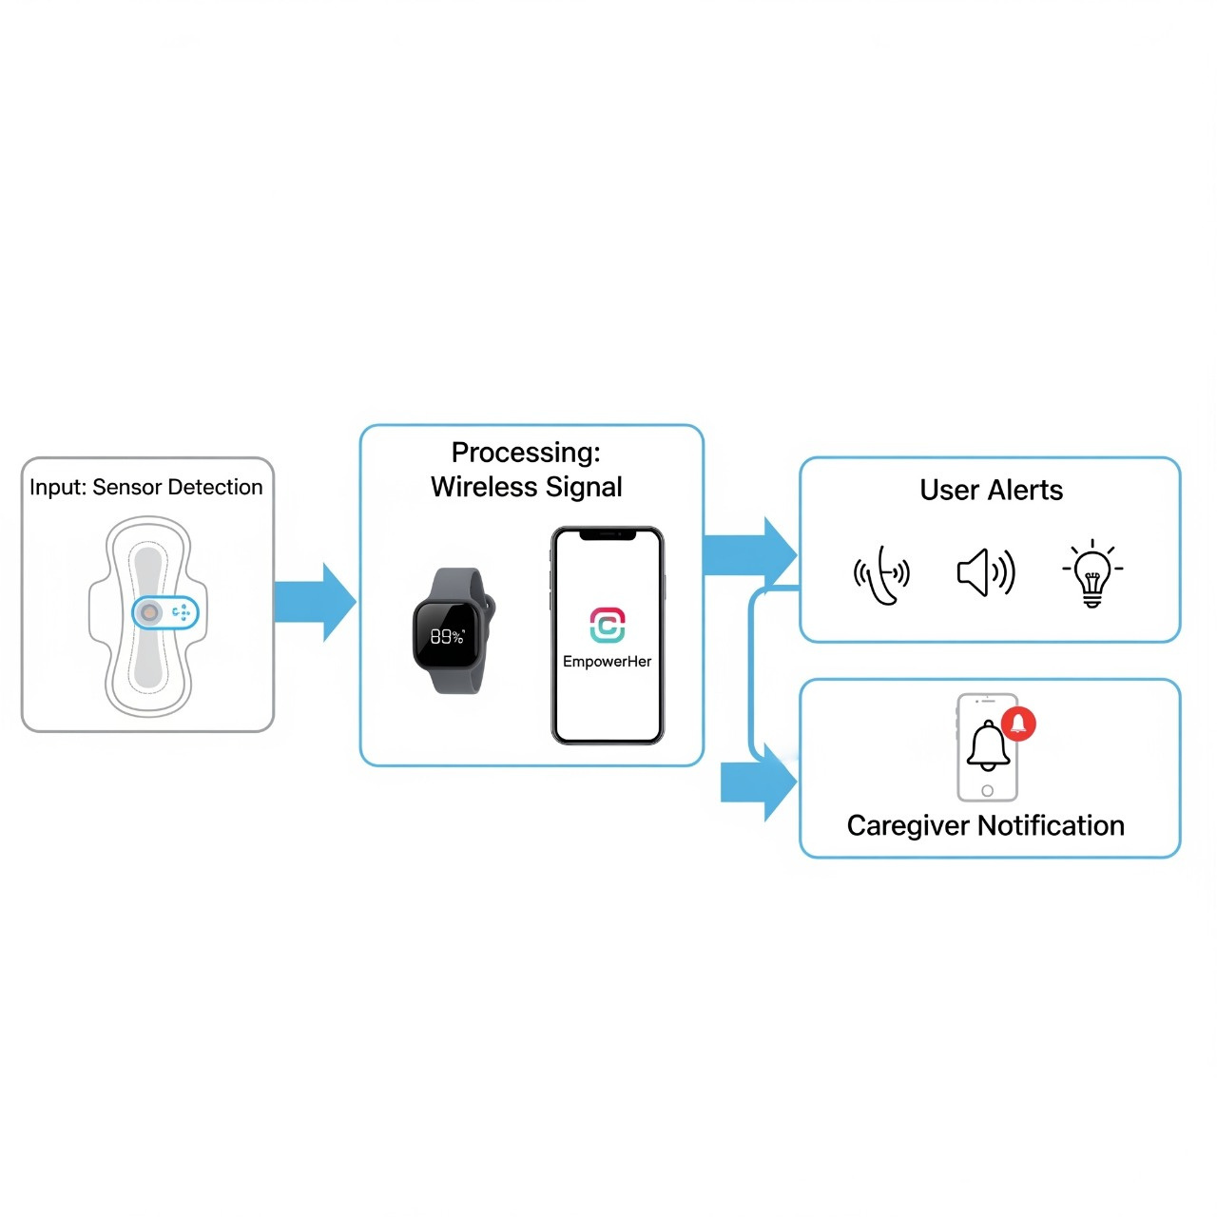
FLOW CHART

Slide 5
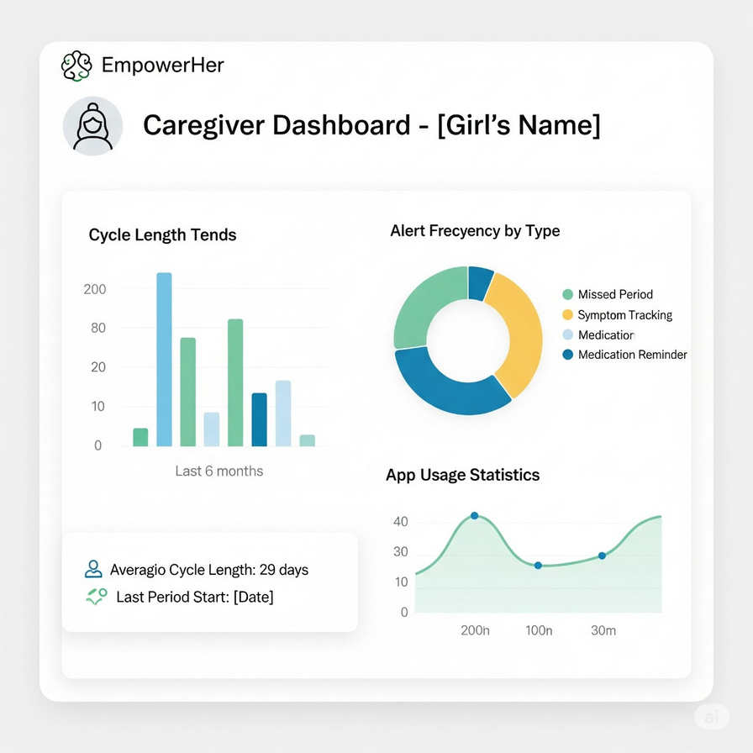
Technical Approach
Hardware
MCU + BLE: ESP32 / nRF52832
Sensors: Moisture/flow detection, optional temp/pH
Alerts: Vibration motor, LED, buzzer
Power: Li-ion battery + solar charging
Software
Firmware: Arduino / ESP-IDF (C/C++)
Mobile App: Android (Kotlin) / Flutter (cross-platform)
Connectivity: Bluetooth Low Energy (BLE GATT)
Features: Period start & end detection, cycle prediction, alerts (voice, vibration, visual)
Tools
Arduino IDE / PlatformIO
Android Studio / MIT App Inventor (prototype)
KiCad (PCB), 3D printing (enclosure)

Slide 6



IMPACT
BENEFITS
Self-Reliance
Confidence Boost
Hygiene Assurance
Economic Feasibility
Universal Accessibility
Improved Quality of Life
Social Inclusion
Empowers disabled girls.
Ensures health & hygiene.
Reduces caregiver stress.
Promotes inclusivity.
Affordable & eco-friendly.
Encourages social awareness.

Slide 7

Conclusion and Future Scope
Our Period Alert System for Disabled Girls provides an innovative, affordable, and inclusive solution to track menstrual cycles using sensors, smart alerts, and mobile integration. It empowers disabled girls with independence, ensures hygiene, and promotes dignity while reducing caregiver stress.
Future Vision – Powering Tomorrow’s Health Tech
AI Intelligence → Personalized period predictions.
IoT Ecosystem → Seamless device-to-device connectivity.
Smart Nanotech Sensors → Invisible, washable, ultra-thin wearables.
Blockchain Privacy → 100% secure health data.
5G Instant Alerts → Lightning-fast, reliable notifications.

Slide 8


Thank you for listening!

